Slide 1



Environmental monitoring

Slide 2



Project definition and design thinking

Slide 3
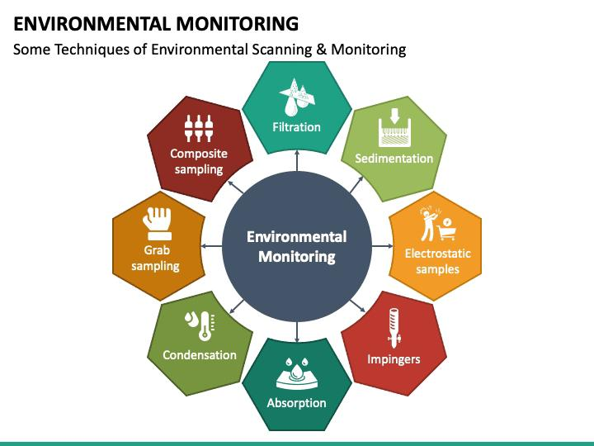
....

Slide 4
DEFINITION
Pollution monitoring refers to the quantitative or qualitative measure of the presence, effect, or level of any polluting substance in a defined environment (air, water, or soil).
Environmental monitoring is a tool to assess environmental conditions and trends, support policy development and its implementation, and develop information for reporting to national policymakers, international forums and the public.

Slide 5
....
Pollution monitoring refers to the quantitative or qualitative measure of the presence, effect, or level of any polluting substance in a environment
Validation and verification of cleaning and sanitation programs. ...
Provides data of the overall effectiveness of your sanitary program, personnel practices, and operations procedures. ..

Slide 6
....
TYPES OF ENVIRONMENT MONITORING
Air quality
Water quality
Noise quality
Biodiversity

Slide 7
DESIGN THINKING
Define objectives such as real-time environmental monitoring, aiding park visitors in activity planning, promoting outdoor experiences, and enhancing visitor satisfaction.
IoT Devices Designs: Plan the deployment of IoT sensors (e.g., temperature and humidity sensors) in public parks.

Slide 8
....
Environmental Monitoring Platform: Design a web-based platform to display real time environmental data to the public.
Integration Approach: Determine how IoT devices will send data to the environmental monitoring platform.
Environmental monitoring is the process of collecting and analyzing data on the physical, chemical, biological, and social aspects of the environment. It is essential for assessing the impacts of human activities, identifying environmental problems, and evaluating the effectiveness of management actions.

Slide 9

.......

